Slide 1
Customer Shopping Behavior Analysis
Analyzing 3,900 purchases to uncover insights into spending patterns, customer segments, and subscription behavior that drive strategic business decisions.

Slide 2


Dataset Overview
3,900
Total Purchases
18
Data Points
Transactions analyzed across all categories
Features covering demographics and behavior
50
Locations
Geographic distribution of customers
$59.76
Average Purchase
Mean transaction value per customer
Dataset includes customer demographics, purchase details, shopping behavior, and 37 missing values in Review Rating column (imputed using median).

Slide 3
Data Preparation Process
01 02 03
Data Loading & Exploration Missing Data Handling Feature Engineering
Imported dataset using pandas, checked structure with df.info() and summary statistics
Imputed 37 missing Review Rating values using median rating per product category
Created age_group bins and purchase_frequency_days columns for deeper analysis
04 05
Data Consistency Database Integration
Standardized columns to snake case, dropped redundant promo_code_used field
Connected to PostgreSQL and loaded cleaned DataFrame for SQL analysis

Slide 4
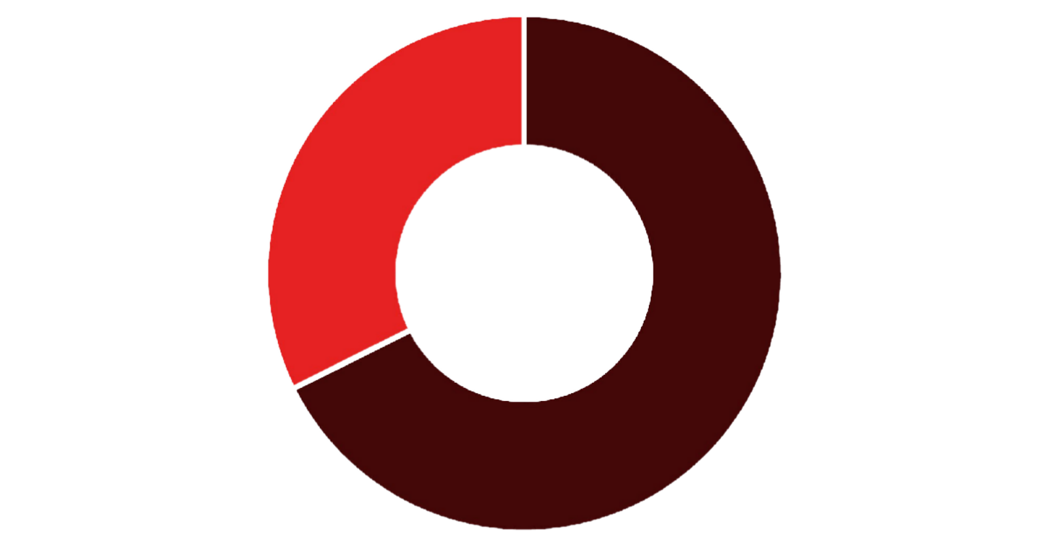


Revenue Insights by Demographics
Gender Revenue Split
Age Group Performance
Revenue by Age Segment:
Young Adult: $62,143
Middle-aged: $59,197
Adult: $55,978
Senior: $55,763
Young adults lead revenue generation, presenting key targeting opportunities.
Male Female
Male customers generate 68% of total revenue, significantly outpacing female customers at 32%.

Slide 5
Product Performance Analysis
Top Rated: Gloves
Sandals
Boots
3.86 average rating
3.84 average rating
3.82 average rating
Category Leaders
Discount-Dependent Items
Clothing: Blouse (171 orders)
Accessories: Jewelry (171 orders) Footwear: Sandals (160 orders) Outerwear: Jacket (163 orders)
Hat: 50% discount rate
Sneakers: 49.66%
Coat: 49.07%
Sweater: 48.17%

Slide 6



Customer Segmentation
1
New Customers
83 customers
Returning Buyers
701 customers
2
Loyal Customers
3
3,116 customers
The customer base is dominated by loyal buyers (80%), indicating strong retention. However, only 2% are new customers, suggesting opportunities to expand acquisition efforts.

Slide 7
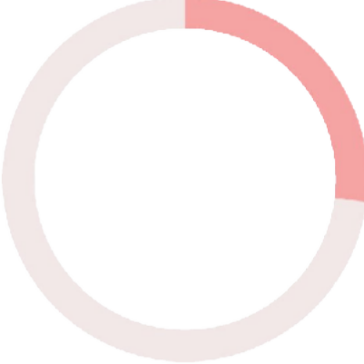

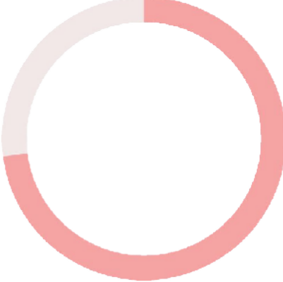
Subscription & Loyalty Patterns
27%
Subscribers
1,053 customers
73%
Non-Subscribers
2,847 customers
Spending Comparison
Subscribers: $59.49 avg spend
Non-subscribers: $59.87 avg spend
Minimal spending difference suggests subscription benefits need enhancement.
Repeat Buyer Insights

Slide 8

Shipping & Discount Behavior
Express Shipping
$60.48 average purchase
Standard Shipping
$58.46 average purchase
High-Value Discounts
839 customers used discounts but spent above average
Premium shipping users spend 3.5% more per transaction
Most common shipping choice among customers
Strategic discounting drives premium purchases

Slide 9
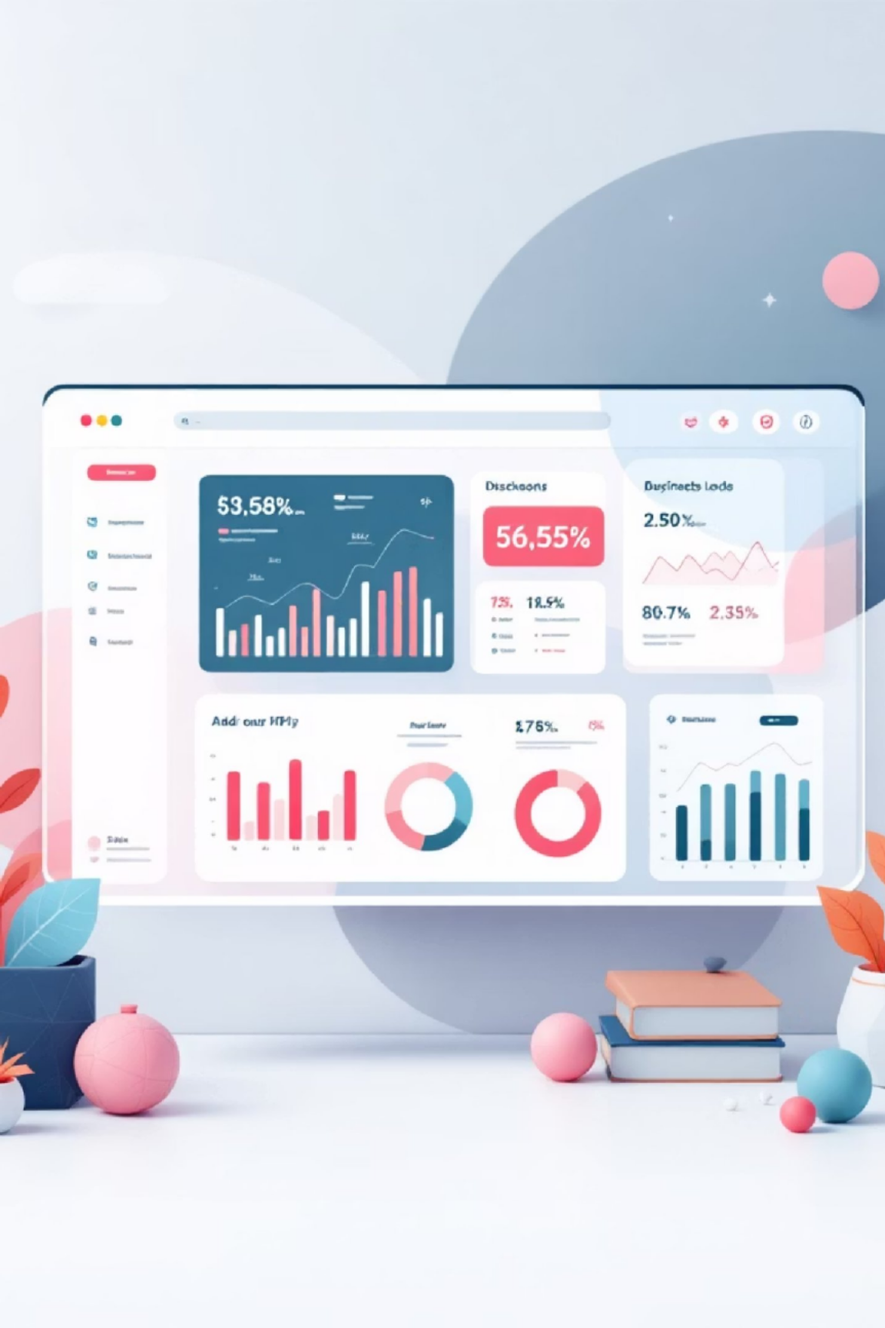


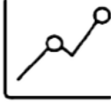
Power BI Dashboard Highlights
Interactive Visualizations
Real-time filtering by subscription status, gender, category, and shipping type
Key Metrics
3.9K customers, $59.76 average purchase, 3.75 average rating tracked continuously
Revenue Analysis
Category and age group breakdowns reveal high-performing segments

Slide 10


Strategic Recommendations
Boost Subscriptions
Promote exclusive benefits to convert high- frequency buyers into subscribers
Loyalty Programs
Reward repeat buyers to accelerate movement into loyal customer segment
Optimize Discounts
Balance promotional sales with margin control for sustainable growth
Product Positioning
Targeted Marketing
Highlight top-rated items (Gloves, Sandals, Boots) and best-sellers in marketing campaigns
Focus efforts on young adults and express-shipping users who demonstrate higher spending patterns

